Slide 1

11th i-CoMSE Workshop: Mesoscale Particle-Based Modeling Mississippi State University July 21–25, 2025
Multiparticle collision dynamics I
Session 12: Coupling to colloids

Slide 2
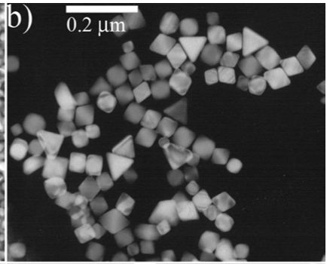
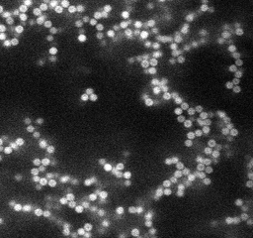
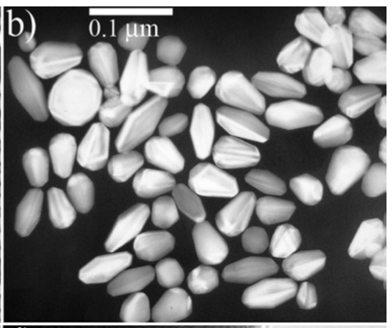
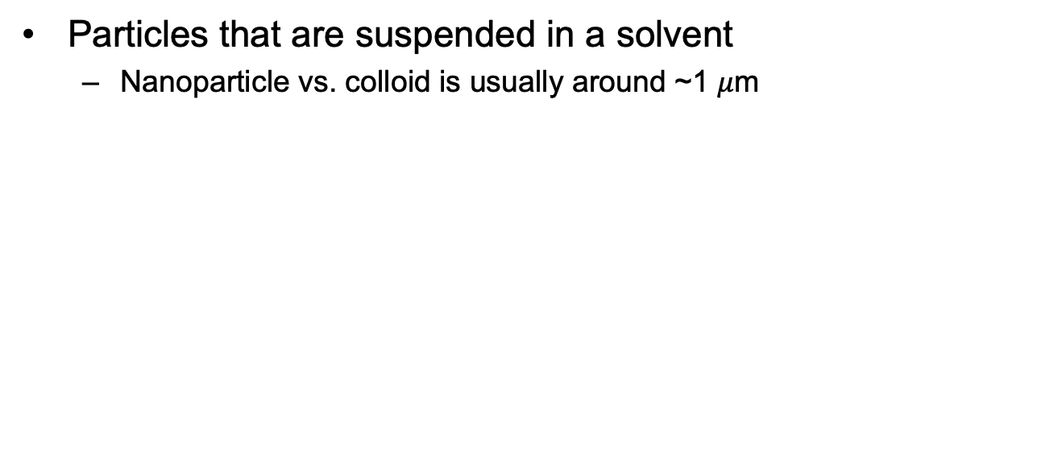
Nanoparticles / colloids
Particles that are suspended in a solvent
Nanoparticle vs. colloid is usually around ~1 $μ$m
https://faculty.college.emory.edu/sites/weeks/lab/gelpage
J. Zhang et al. Adv. Funct. Mater. 17, 3295 (2007)

Slide 3
Nanoparticles / colloids
Objective: model hydrodynamic interactions on particles and between particles
Can play an important role on both individual and collective dynamics

Slide 4
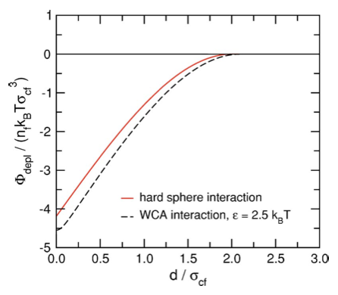
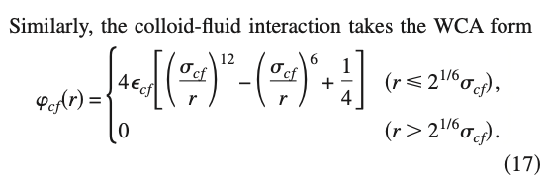
Nanoparticles / colloids in MPCD
Central pairwise potentials (like WCA)
Potential drawbacks
Expensive (we wanted to get rid of pair potentials for the solvent!)
No tangential forces (slip)
J.T. Padding and A.A. Louis. Phys. Rev. E 74, 031402 (2006).

Slide 5
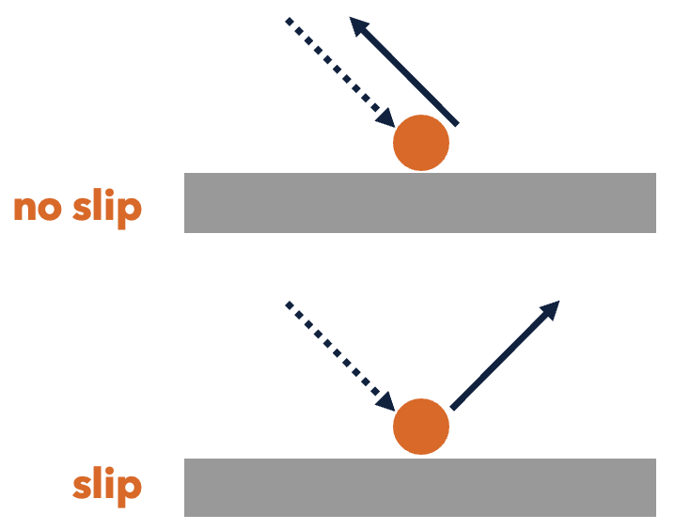
Nanoparticles / colloids in MPCD
Bounce-back coupling
Reflect the velocity when particle hits, or
Draw new particle velocities
Potential drawbacks
Needs collision detection (as expensive as computing pairwise interactions)
May introduce artificial forces (like depletion)
How to handle collisions in cells near surfaces of particles (will discuss this problem more in upcoming sessions)
Ex: J.K. Whitmer and E. Luijten. J. Phys.: Condens. Matter 22, 104106 (2010).

Slide 6
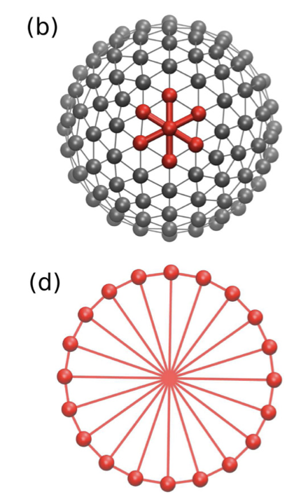
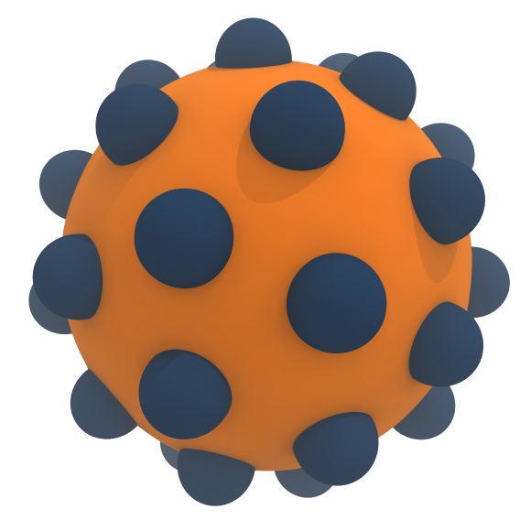
Nanoparticles / colloids in MPCD
Collision coupling
Discretize surface of the particle
Surface particles participate in collision step (rather than streaming step)
Potential drawbacks
Constructing the particle model is more challenging
Need to hold shape of the particle together (stiff springs)
S. Poblete et al. Phys. Rev. E 90, 033314 (2014).

Slide 7
Exercise: Sedimentation of a sphere
Sedimentation is the process of a colloidal particle falling through a fluid, usually due to a density mismatch.
Force balance: sum of forces on colloids and solvent must match
Finite-size effects: periodic boundary conditions slow the motion of the particle compared to being in an infinite volume.
F_{c}

Slide 8
Questions
How to construct the model?
We have a tool for converting STL files to HOOMD inputs if you are interested!
What should the density of surface particles be? Does it matter?
What can go wrong?
Shape gets too floppy if springs are too soft
Simulation blows up if bad integration of springs
Tradeoff in signal-to-noise ratio for applied force, may get physical instabilities if force is too large for suspensions
Can I simulate active particles? Yes, with the right model!

